Slide 1


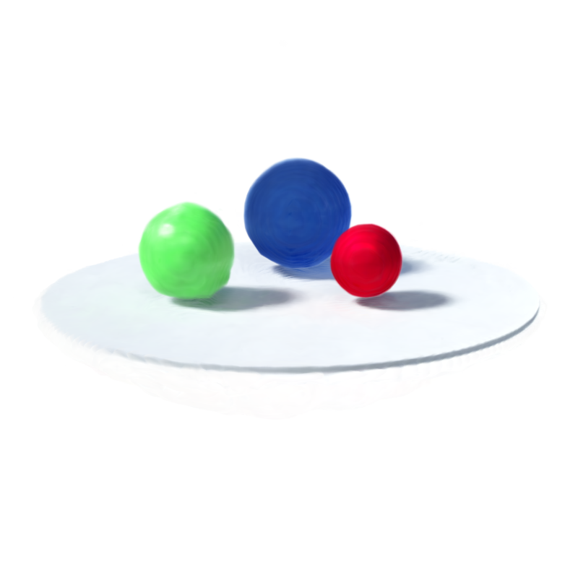




$$t_{i−1}$$
$$t_{i−1}$$
time $i$+1
Eulerian View
Canonical Space
Lagrangian View

Slide 2

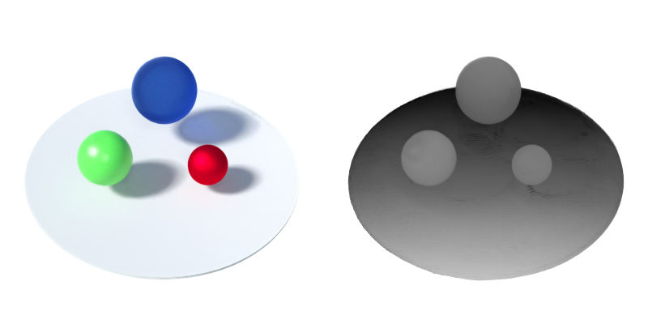
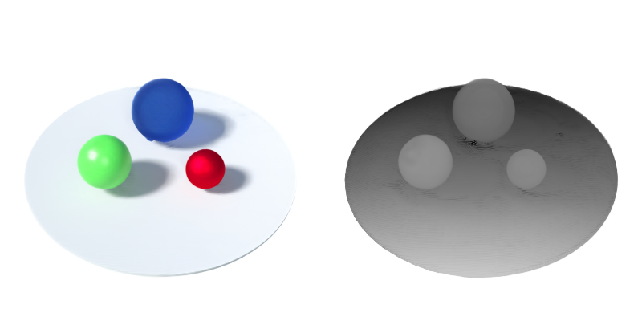
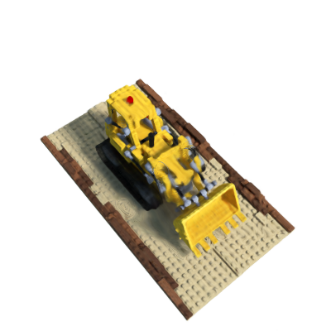
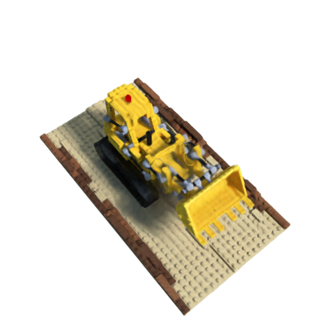
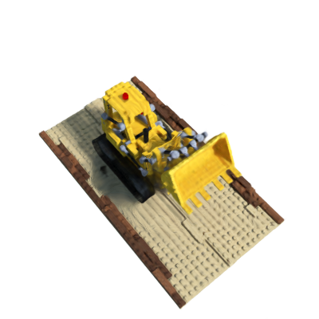






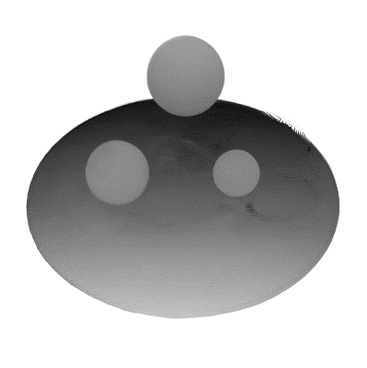
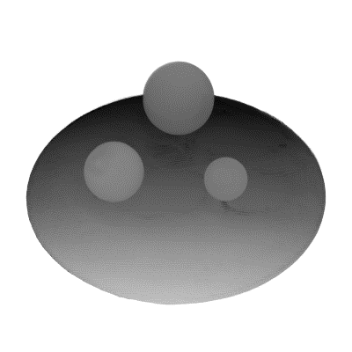
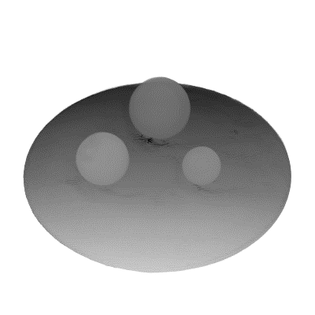
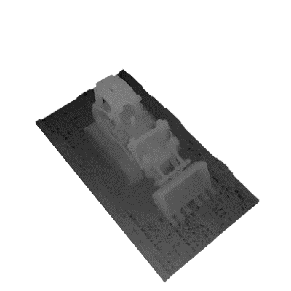
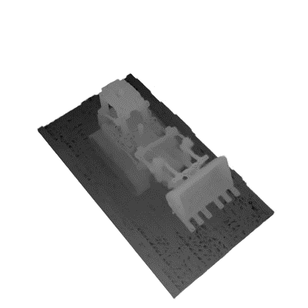
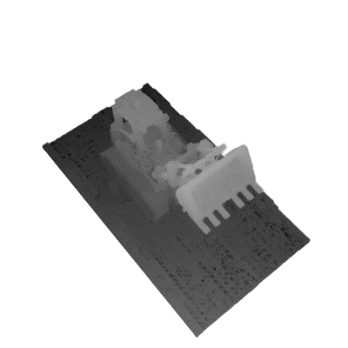


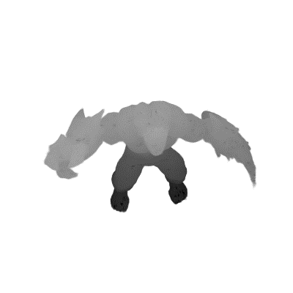
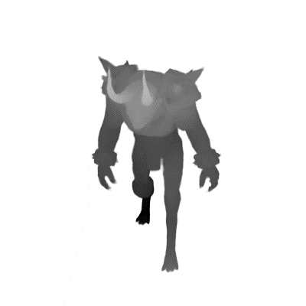


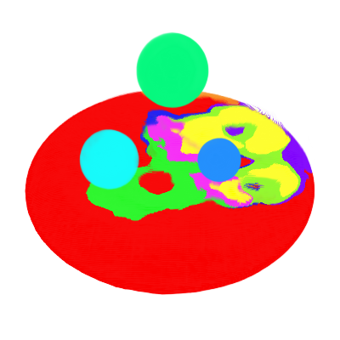
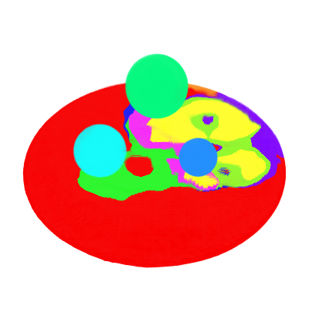
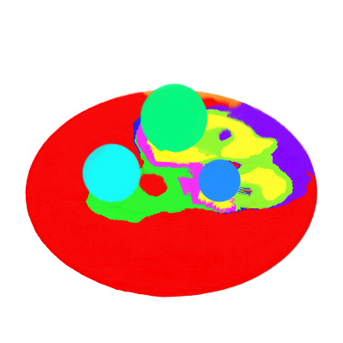
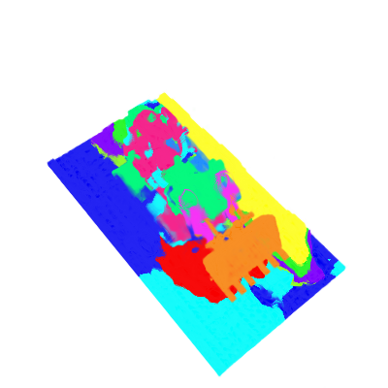
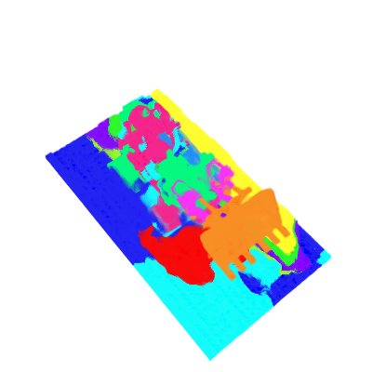
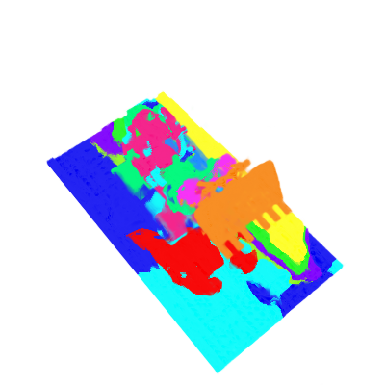
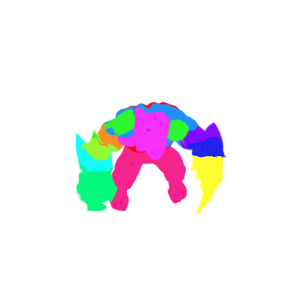

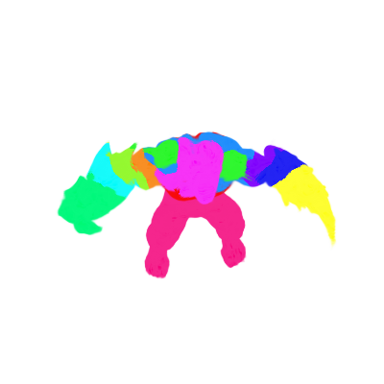
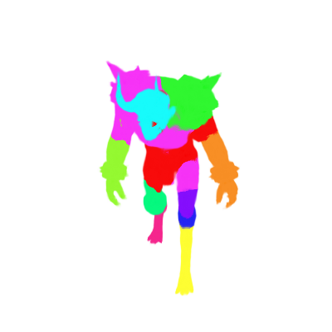





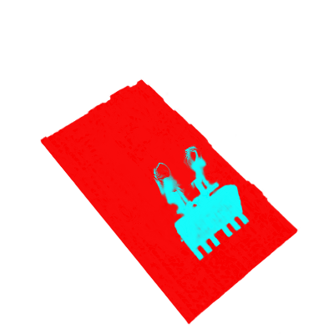

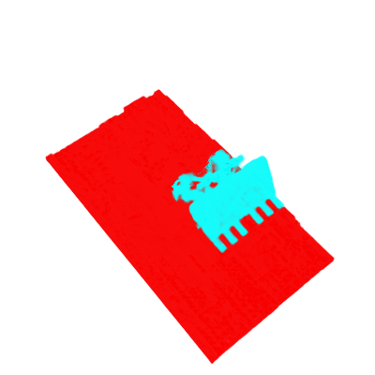






Bouncing Balls
Lego
Mutant
Hell Warrior
Rendered images
Depth
Groups
Merged groups

Slide 3
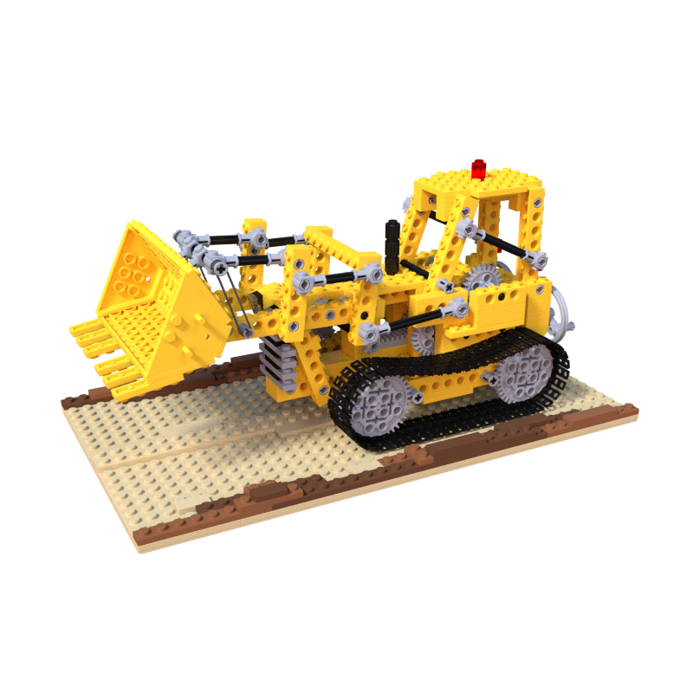
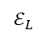

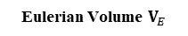
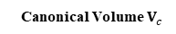
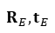
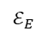
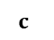

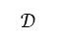
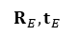
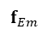
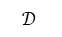

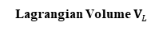
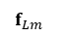
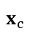
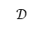
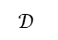
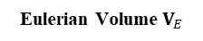
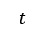
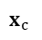

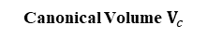
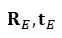

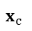
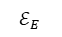
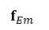
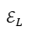

































Eulerian Volume $V_{E}$
Eulerian Module
Canonical Module
$$ℰ_{E}$$
$$f_{Em}$$
$$𝒟$$
$$R_{E},t_{E}$$
$$x$$
$$x_{c}$$
$$V_{c}$$
Eulerian Volume $V_{E}$
Eulerian Motion Modeling
Canonical Volume $V_{c}$
Eulerian Volume $V_{E}$
Eulerian Motion Modeling
Canonical Volume $V_{c}$
$$t$$
Cycle
Consistency
A Specific Location
$$ℰ_{E}$$
$$f_{Em}$$
$$𝒟$$
$$R_{E},t_{E}$$
$$x$$
$$x_{c}$$
A Specific Location
$$ℰ_{E}$$
$$f_{Em}$$
$$𝒟$$
$$R_{E},t_{E}$$
$$x$$
$$x_{c}$$
$$x$$
$$t$$
$$t$$
Cycle
Consistency
$$t$$
Cycle
Consistency
$$x_{c}$$
$$R_{L}^{−1},−t_{L}$$
$$𝒟$$
$$f_{Lm}$$
$$ℰ_{L}$$
$$𝒢$$
$$σ$$
$$t$$
$$t$$
Lagrangian Module
Lagrangian Volume $V_{L}$
d
$$c$$
$$x$$
$$x_{c}$$
$$R_{L}^{−1},−t_{L}$$
$$𝒟$$
$$f_{Lm}$$
$$ℰ_{L}$$
$$𝒢$$
A Specific Particle
$$σ$$
$$x$$
$$x_{c}$$
$$R_{L}^{−1},−t_{L}$$
$$𝒟$$
$$f_{Lm}$$
$$ℰ_{L}$$
$$𝒢$$
A Specific Particle
$$σ$$
Lagrangian Motion Modeling
Lagrangian Volume $V_{L}$
d
$$c$$
Lagrangian Motion Modeling
Lagrangian Volume $V_{L}$
d
$$c$$
Eulerian Volume $V_{E}$
$$ℰ_{E}$$
Eulerian Motion Modeling
Canonical Volume $V_{c}$
Cycle
Consistency
A Specific Location
$$t$$
$$f_{Em}$$
$$𝒟$$
$$R_{E},t_{E}$$
$$x$$
$$x_{c}$$
$$x$$
$$R_{L}^{−1},−t_{L}$$
$$t$$
$$σ$$
$$x_{c}$$
$$𝒟$$
$$f_{Lm}$$
$$ℰ_{L}$$
$$𝒢$$
Lagrangian Volume $V_{L}$
d
$$c$$
Lagrangian Motion Modeling
A Specific Particle

Slide 4


















Eulerian Volume $V_{E}$
$$ℰ_{E}$$
Eulerian Motion Modeling
Canonical Volume $V_{c}$
A Specific Location
$$t$$
$$f_{Em}$$
$$𝒟$$
$$R_{E},t_{E}$$
$$x$$
$$x_{c}$$
Cycle
Consistency
$$t$$
$$x$$
$$x_{c}$$
$$R_{L}^{−1},−t_{L}$$
$$𝒟$$
$$f_{Lm}$$
$$ℰ_{L}$$
$$𝒢$$
A Specific Particle
$$σ$$
Lagrangian Motion Modeling
Lagrangian Volume $V_{L}$
d
$$c$$
Eulerian Volume $V_{E}$
$$ℰ_{E}$$
Eulerian Motion Modeling
Canonical Volume $V_{c}$
A Specific Location
$$t$$
$$f_{Em}$$
$$𝒟_{E}$$
$$R_{E},t_{E}$$
$$x$$
$$x_{c}$$
$$x$$
$$R_{L}^{−1},−t_{L}$$
Cycle
Consistency
$$t$$
$$x_{c}$$
$$𝒟_{L}$$
$$f_{Lm}$$
$$ℰ_{L}$$
$$𝒢$$
A Specific Particle
$$σ$$
Lagrangian Motion Modeling
Lagrangian Volume $V_{L}$
d
$$c$$

Slide 5





$\{f_{Lx}^{i}\}$
$$γ$$
$$\hat{A}$$
average &
assignment
$$\{{\hat{f}}_{L}^{i}\}$$
straight
through
$$\{S^{l}\}$$

Slide 6

Lagrangian Feature $\{{\hat{f}}_{L}^{i}\}$
Sampled Times
Transformation Sequences
Merge Steps
Rigid Transformation Decoder
Sort
APE Cost

Slide 7



















Slide 8


























Synthetic Scene Editing
Rescaling
Re-posing
Duplication
Removal
Real-world Scenes Editing
Removal
Modification

Slide 9











1 | 0.960 | 0.943 | 0.950
2 | 0.907 | 0.838 | 0.951
3 | 0.890 | 0.832 | 0.930
4 | 0.897 | 0.846 | 0.904
5 | 0.887 | 0.880 | 0.861
①
②
③
④
⑤
⑥
 | ① | ② | ③ | ④ | ⑤ | ⑥ | ⑦ | ⑧
mIOU | 0.951 | 0.838 | 0.890 | 0.905 | 0.846 | 0.887 | 0.861 | 0.880
⑦
⑧
Input
Ground Truth
Groups
Input
Ground Truth
Groups
mIOU: 0.951
mIOU: 0.838
mIOU: 0.890
mIOU: 0.905
mIOU: 0.846
mIOU: 0.887
mIOU: 0.861
mIOU: 0.880
Input
Ground Truth
Groups
Input
Ground Truth
Groups

Slide 10

























Slide 12
























Hell Warrior
Hook
Jumping Jacks
Rendered images
Depth
Groups
Merged groups

Slide 13
Hell Warrior
Hook
Jumping Jacks
Rendered images
Depth
Groups
Merged groups

Slide 14












Hook
Jumping Jacks
T-Rex
Hell Warrior
Rendered images
Depth
Groups
Merged groups

Slide 15








Removing
Modification

Slide 16











Slide 17






Reconstructed sequence and grouping results
Duplication
Deletion
Rescaling
Re-posing
Reconstructed sequence and grouping results
Duplication
Deletion
Rescaling
Re-posing

Slide 18




































Bouncing Balls
Lego
Mutant
Rendered images
Depth
Groups
Merged groups

Slide 19

















Slide 20


Eulerian View
…
time
Frame Space
Lagrangian View
Canonical Space

Slide 21








part discovery
Eulerian View
…
time
Frame Space
Lagrangian View
Canonical Space
Eulerian View
Part Discovery
time
…
time
Lagrangian View
Per Frame World Space
Canonical Space
Lagrangian View

Slide 22




Eulerian View
time
Frame Space
Lagrangian View
Canonical Space

Slide 23











Slide 24
















Observed Sequence
Grouping Results
Dense Tracking
Duplication
Deletion
Rescale
Repose

Slide 25
Reconstructed Sequence
Dense Tracking
Grouping Results
Duplication
Deletion
Rescaling
Re-posing

Slide 26





















